Slide 1
Northern Guilford Middle School
Registration and Tips
for
Middle School Success
Hosted By: Mrs. Hunter and Mrs. Johnson

Slide 2
NGMS School Counseling Program
Individual student concerns/sessions
Scheduling/Registration
Small group counseling
Classroom counseling
Career exploration
Social/Emotional Support
Parent/Student/Teacher conferences
504 questions
Attendance
Mental health referral information
Food and school supply assistance
AND MORE…

Slide 3
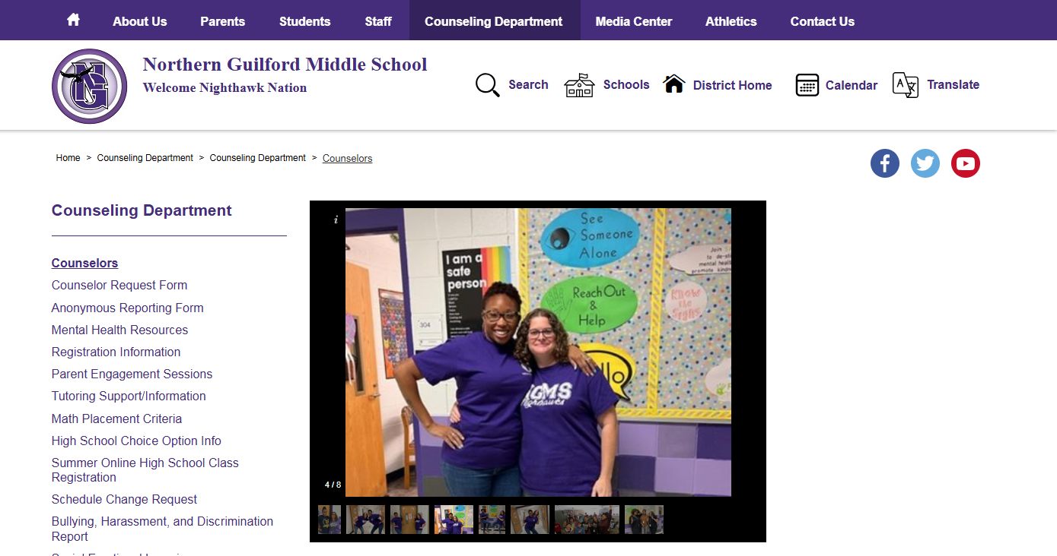
NGMS Counseling Department Website
NGMS Counseling Department Website

Slide 4
Counselor/Student Registration February 24-March 28
During this time counselors will meet one on one with students to guide them through the registration process and ensure that they have selected the right classes.

Slide 5
Math Levels
6th | 7th | 8th
Math 6 Accelerated Math 6 AIMM | Math 7 Accelerated Math 7 Math 1 | Math 8 Math 1 Math II

Slide 6
Spanish and CDM
Spanish taken in both 7th and 8th grade counts as 1 foreign language high school credit
CDM-Credit by Demonstrated Mastery
Students fluent in a 2nd language can test and receive high school credit (Fall/Spring opportunities)

Slide 7
Arts Requirement
Beginning in Fall 2022, students entering Grade 6 and subsequently entering Grade 9 for the first time in 2025-26 shall have at least one arts education course in grades 6-12 to meet graduation requirements.

Slide 8
5 Ways to Make it Great!!
Social Media/Cell Phone Use
Getting Involved
Student Organization
Communicating with Teachers
Mental Health Resources

Slide 9
Social Media
Digital Etiquette-Let's be honest-they don't have it
Social media-restrict and monitor
Age Limits (13 years old)
Snapchat, Instagram, Tik Tok, Discord
Time limits
They need boundaries

Slide 10
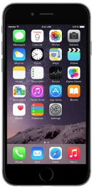
Cell Phone Safety
Parental Monitoring
Bark Login
AURA
Verizon Smart Family
Iphone Monitoring-Apple
Check in times/Time limits-Good old fashioned "give me your phone"

Slide 11
Getting Involved
Sports
Clubs
GCS Virtual Helpline
PTSA
Community

Slide 12
Student Organization
Locker- Clean out monthly
Binders-Weekly bag check
Cell Phones/AirPods in Locker
Planner/Canvas
PowerSchool
Parent Portal

Slide 13
Parent Communication
School Website
Canvas
PowerSchool Parent Portal
Connect Ed / Emails
Parent/Teacher Conferences

Slide 14
Resources: School- Based Mental Health Services
NGMS Support
School Counselors
School Social Worker
School Psychologist
Mental Health Resources
Tele-Therapy
Day Break

Slide 15
Questions?
Tierra Johnson
johnsot3@gcsnc.com
Theresa Hunter
huntert3@gcsnc.com

